Slide 1
Shape cutout from screenshot
https://blog.slidemagic.com/blog/2018/1/9/how-to-cut-out-shapes-out-of-images-in-powerpoint

Slide 2
filter: none
Light:-48
Color:100%
clarity:100%
Vignette: -25

Slide 3
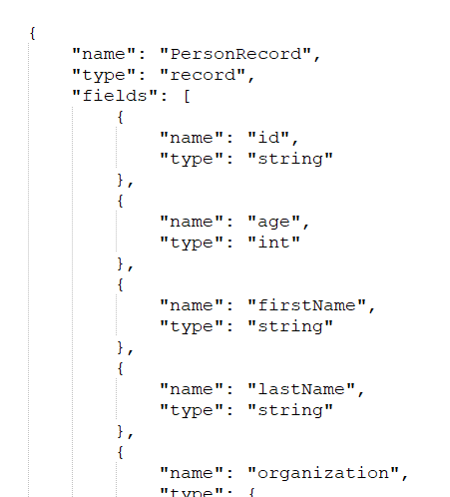
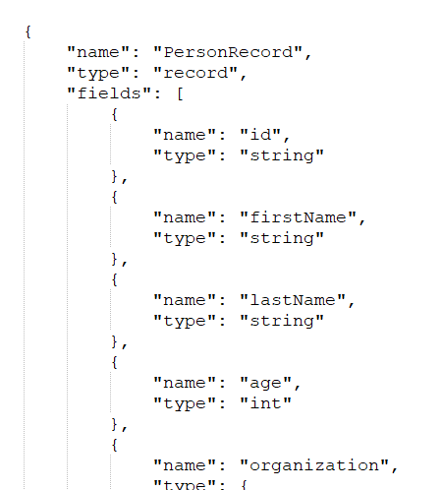
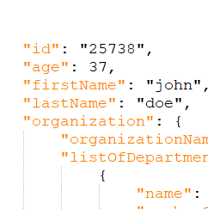
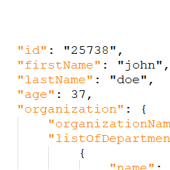
input
output
old record
new record
old schema
new schema
Notes:
Page to describe order change

Slide 4
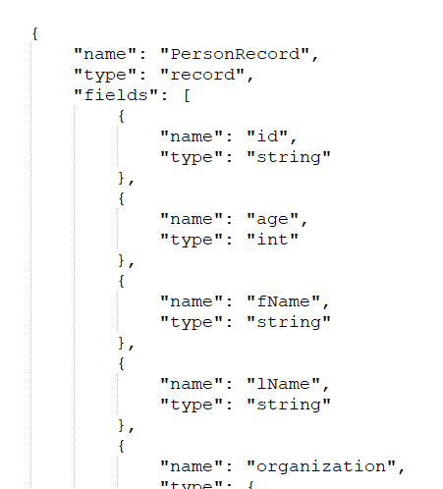
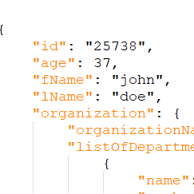
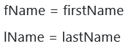
input
output
renamed list
old record
new record
old schema
new schema
Notes:
Page to describe name change no alias

Slide 5
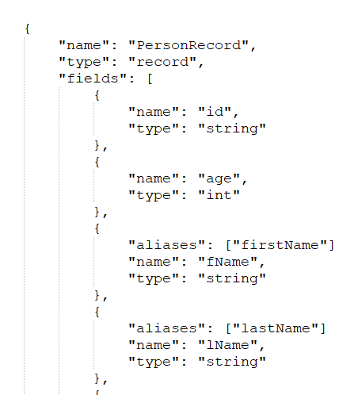
input
output
old record
new record
old schema
new schema
Notes:
Page to describe name change w alias

